Slide 1
Covid-19 Detection from X-Ray Images using 2D CNN
Submitted by:
ABDULLAH UMAR NASIB 19166009
SAMIHA KHAN 21266007
JAWAD BIN SAYED 21341025
SUMAIYA MIM 22166007
FAHIM HASNAT 22166016
MD MAZIDUL HASAN 22166018
SM MAHSANUL ISLAM 22166037

Slide 2
Introduction
Coronavirus disease are usually diagnosed as pneumonia
Covid-19 was first discovered in Wuhan, China in December of 2019.
It has affected more than 147 million individuals all over the world.
The only method used for COVID-19 detection is (RT-PCR)real-time reverse transcription-polymerase chain reaction.
It has some drawbacks.
Since, Plain Radiography (chest X-ray) provides an overall picture of this disease.
We tried to build a deep learning model to detect Covid-19 using chest X-ray.

Slide 3
Literature Review
X. Qi, L. G. Brown, D. J. Foran, J. Nosher, and I. Hacihaliloglu, “Chest x-ray image phase features for improved diagnosis of covid-19 using convolutional neural network,” International Journal of computer assisted radiology and surgery, vol. 16, no. 2, pp. 197–206, 2021.
R. Yasin and W. Gouda, “Chest x-ray findings monitoring covid-19 disease course and severity,” Egyptian Journal of Radiology and Nuclear Medicine, vol. 51, no. 1, pp. 1–18, 2020.
W. Wang, Y. Xu, R. Gao, et al., “Detection of SARS-CoV-2 in different types of clinical specimens,” Jama, vol. 323, no. 18, pp. 1843–1844, 2020.

Slide 4
Related Works
Support Vector Machines with various kernel functions
Linear
Quadratic
Cubic
Gaussian
NCOVnet
Deep Convolutional Neural Network

Slide 5
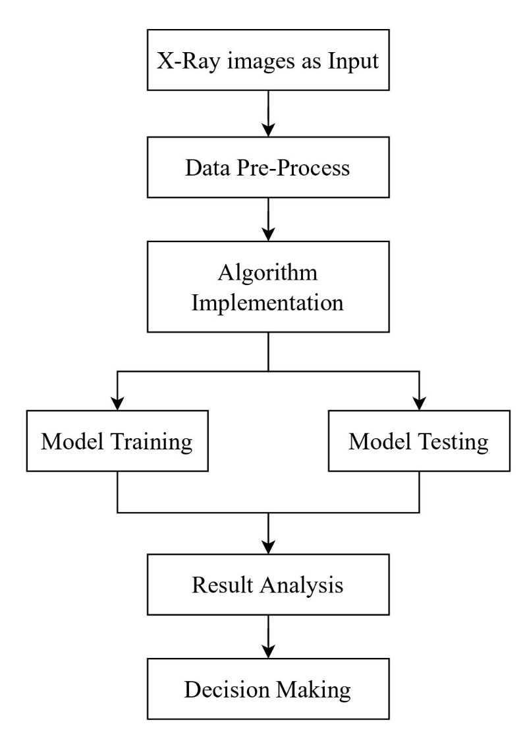
Proposed Model

Slide 6
Dataset Description
25 x-ray images are from normal people
69 x-ray images are from covid-19 affected people
Dataset are collected from kaggle.com
300x300 pixels size for each image
70 images for training
24 images for testing

Slide 7
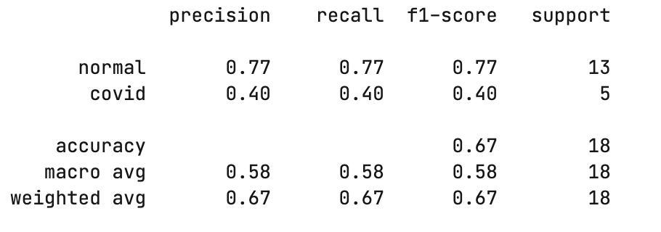
Result Analysis

Slide 8
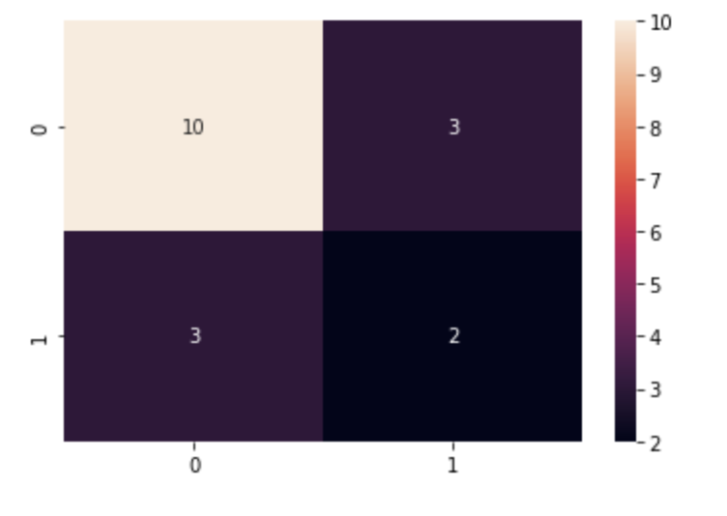
Result Analysis
0 = Normal & 1 = Covid
True Positive : 10
False Positive : 3
False Negative : 3
True Negative : 2

Slide 9
Future Work and Conclusion
Increase the dataset.
Add 3D CNN algorithm and Try a comprehensive comparison between the two methods.
It can be used to detect almost any form of disease using medical imaging. Such as Cancer, Tooth decay, Tumor.

Slide 10
Thank You !

